Slide 1
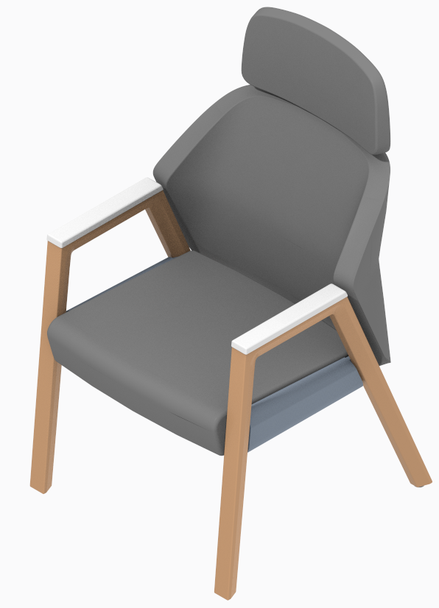
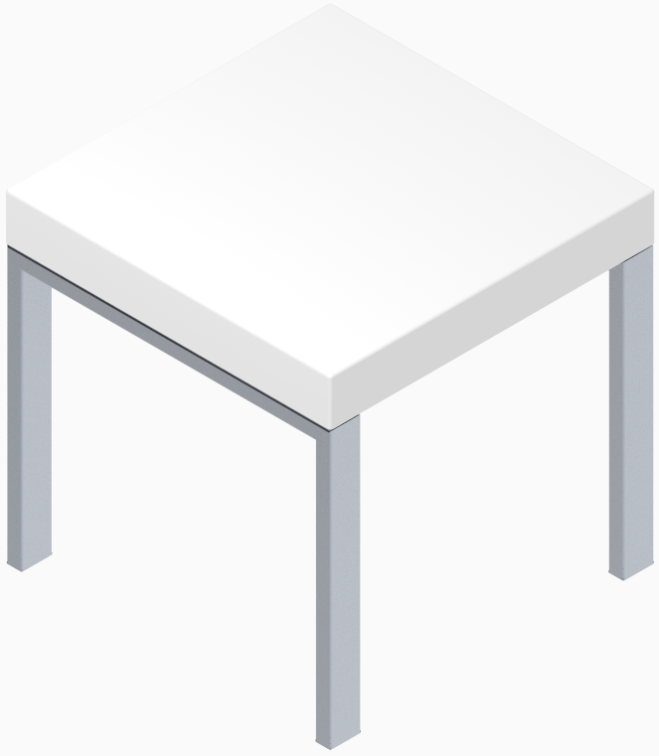
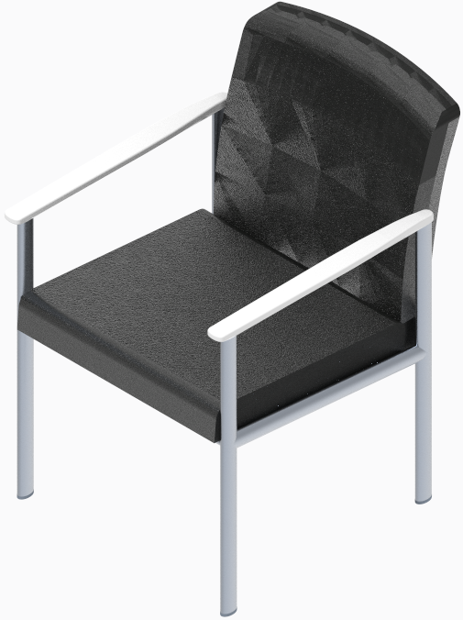
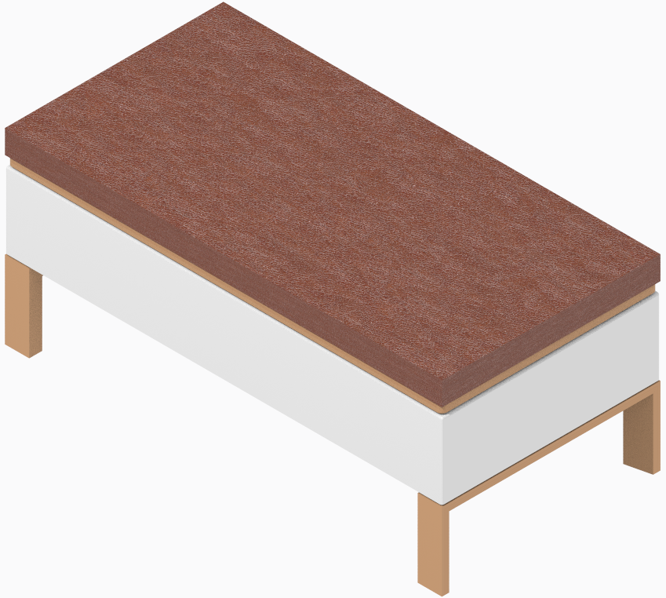
Corian
supply chain strategy

Slide 2
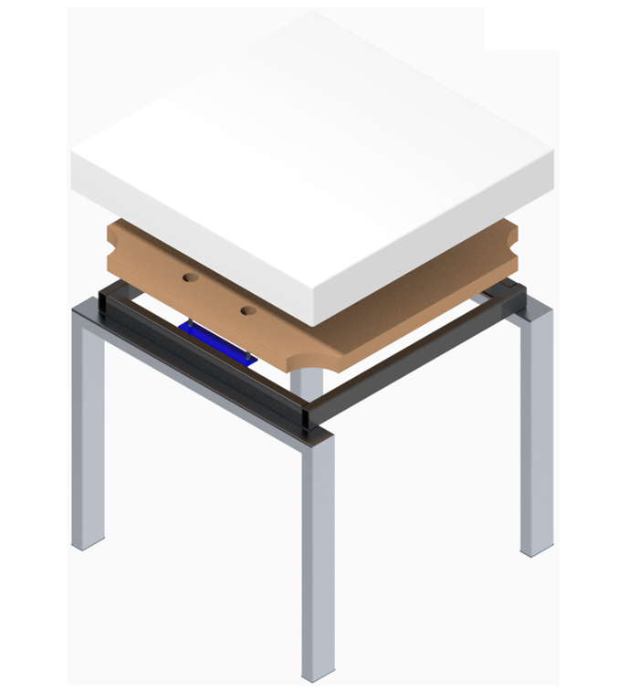
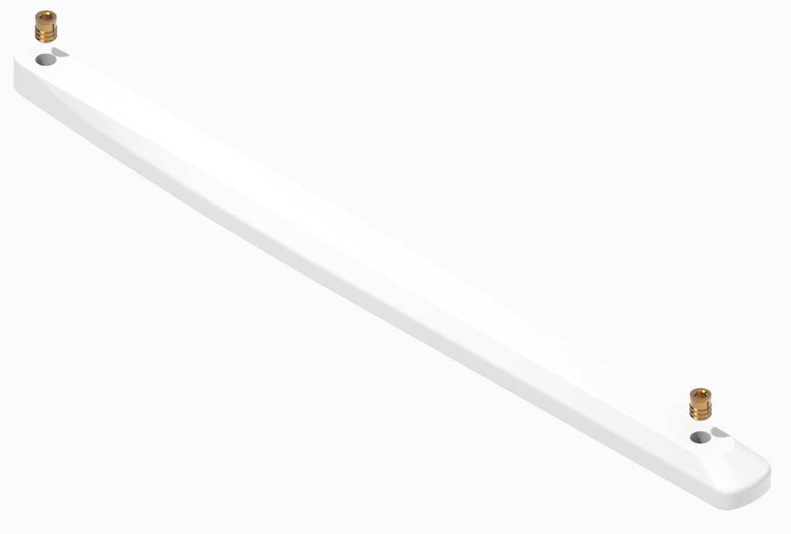
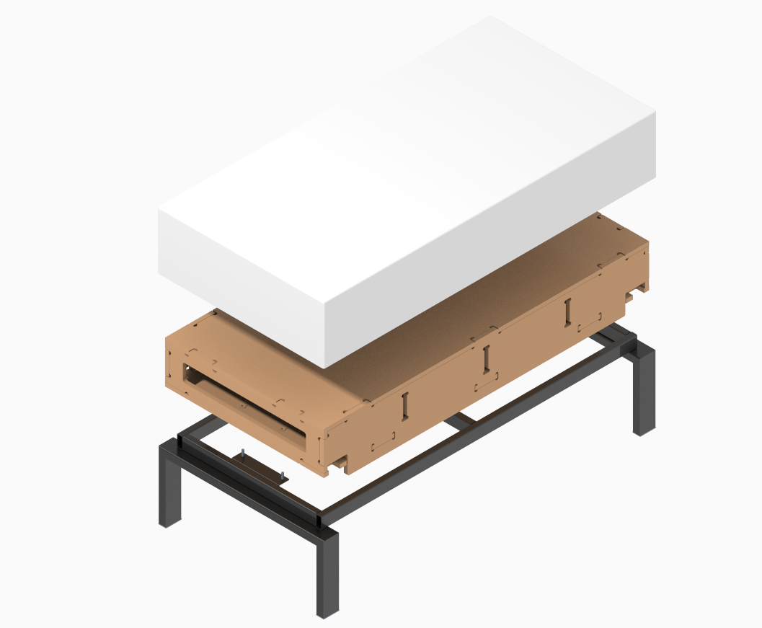
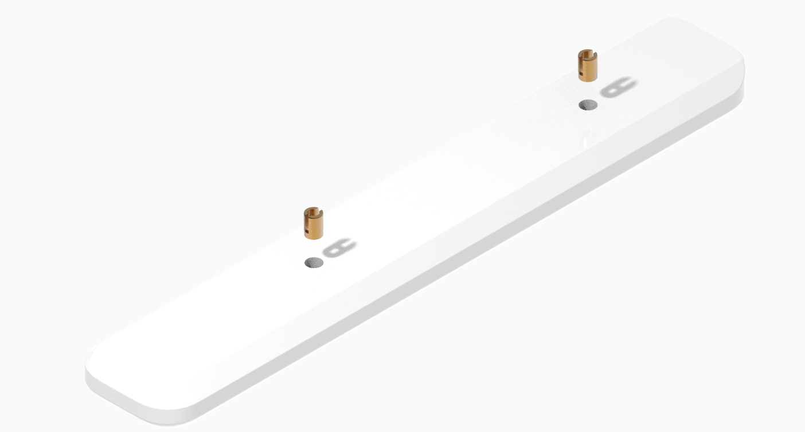
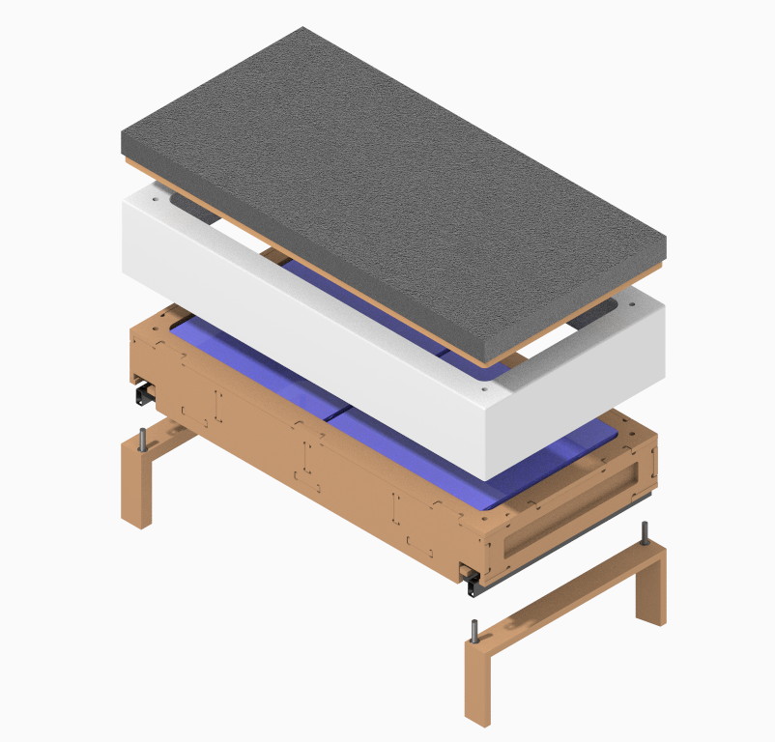
Supply chain strategy (project snapshot)
key dates
visual statement of line
Phase 1a
N/A
Phase 1b
N/A
Phase 2
N/A
phase 3
N/A
FOE
2019.11.20
First Ship
2019.12.23
financials (end of phase 1a)
scope
GM Target
N/A
Launch regions: Americas
Customer lead time: STD Product Lead Time. 5 – 8 weeks, finished product.
Environmental: N/A
Engineering: BIFMA
Seasonality: N/A
Specials Processes: Polish, Sanding.
GM Est.
N/A
CapEx
$35k
OpEx
$15k
Payback Target
<18 months
Payback Est.
4.4 months
volume / revenue
Volume Projections (units)
Offering | Year 1 | Year 2 | Year 3 | Year 4
Aspekt | 1097 | 1097 | 1097 | 1097
Leela | 201 | 201 | 201 | 201
Tava | 520 | 520 | 520 | 520
Embold | 99 | 99 | 185 | 208
Total | 1,917 | 1,917 | 2,003 | 2,026
Net Sales (thousands)
Offering | Year 1 | Year 2 | Year 3 | Year 4
Aspekt
Leela
Tava
Embold
Total

Slide 3
Supply chain strategy (product placement recommendation)
summary & recommendation
Leverage internal core competencies with solid surface material (Corian) process.
assembly
rationale
scs plant
fin good
Solid Surface Aspekt Arm Caps
Extended lead-times, supplier unreliability and cost
Tijuana Plant
Solid Surface Embold Arm Caps
Extended lead-times, supplier unreliability and cost
Tijuana Plant
Solid Surface Leela Table Tops and Plywood Spacers
Extended lead-times, supplier unreliability and cost
Tijuana Plant
Solid Surface Tava Table Tops and Plywood Spacers
Extended lead-times, supplier unreliability and cost
Tijuana Plant

Slide 4
Supply chain strategy (ASPEKT – Arm Cap)
placement
SC Plant
in
Tijuana Plant
*Insert
1068963001 (x2)
Tijuana Plant
Tier 2: Fastenal
* Solid Surface, Arm Cap
1067363001
Tijuana Plant
Tier 2: Dupont (Willis)
Narrative
Joint Adhesive
ASPEKT arm caps to be processed and assembled in Tijuana
N/A
Dupont (Willis)
Patented Dupont glue specific for
Groups Solid Surface Color

Slide 5
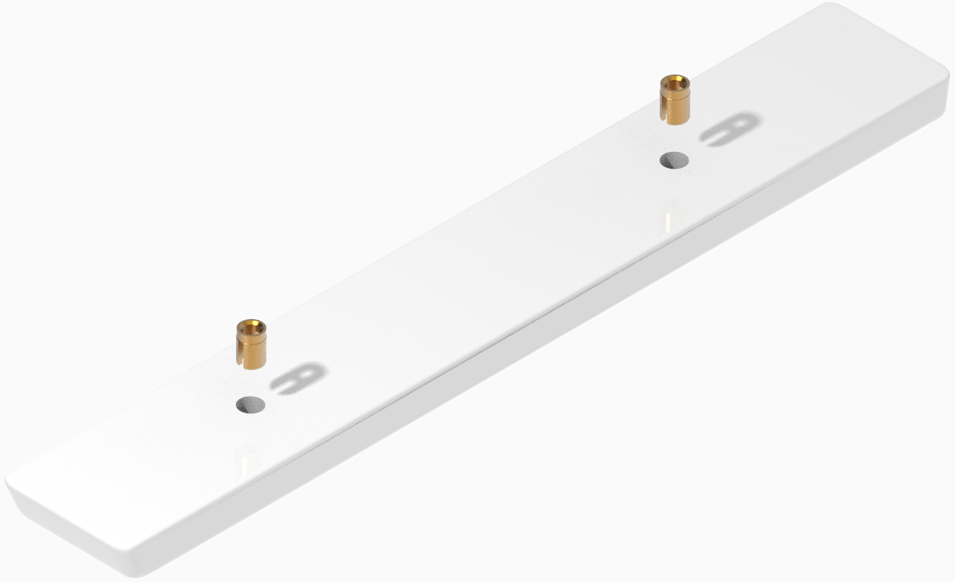
Supply chain strategy (EMBOLD – Arm Caps)
placement
SC Plant
in
Tijuana Plant
*Solid Surface, Arm Cap
1258449001
Tijuana Plant
Tier 2: Dupont (Willis)
Insert
1173170001 (x2)
Fastenal
*Solid Surface, Arm Cap
Installed with an Arbor Press
1150708001
Tijuana Plant
Tier 2: Dupont (Willis)
Narrative
EMBOLD arm caps to be processed and assembled in Tijuana Plant

Slide 6
Supply chain strategy (LEELA - Tables)
placement
SC Plant
in
Tijuana Plant
*Solid Surface, Top
19942401
Tijuana Plant
Tier 2: Dupont (Willis)
Weldment - Frame
20846001
Specialty Steel Products Inc
Available on Merle, Champagne, Platinum & Black finishes (Support Frame + Legs)
*Spacer - Table
20489401
Tijuana Plant
Plywood Baltic Birch
Narrative
LEELA Tables solid surface w/plywood to be processed and assembled in Tijuana Plant

Slide 7
Supply chain strategy (LEELA – Coffee Tables)
placement
SC Plant
in
Tijuana Plant
*Solid Surface, Top
19942403
Tijuana Plant
Tier 2: Dupont (Willis)
Weldment - Frame
20846002
Specialty Steel Products Inc
Available on Merle, Champagne, Platinum & Black finishes (Support Frame + Legs)
*Frame – Coffee Table
20476808
Tijuana Plant
Plywood Baltic Birch
Narrative
LEELA Coffee Tables solid surface to be processed and assembled in Tijuana Plant

Slide 8
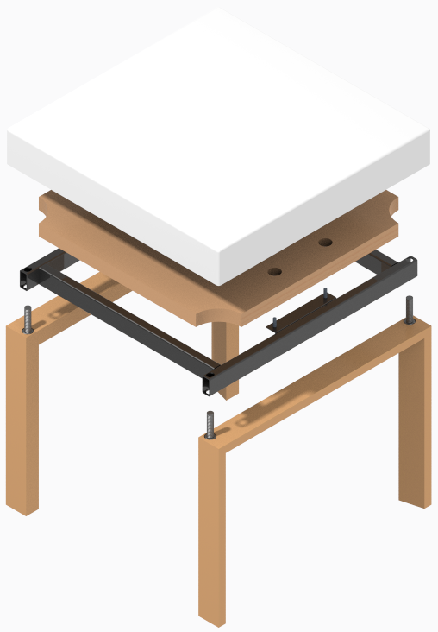
Supply chain strategy (TAVA - Table)
placement
SC Plant
in
Tijuana Plant
*Solid Surface, Top
19942401
Tijuana Plant
*Spacer - Table
Tier 2: Dupont (Willis)
20489401
Tijuana Plant
Plywood Baltic Birch
Frame – Weldment, Table
20476506
Specialty Steel Products Inc
Only available in Black Color
Bolt - Assy
20819001
Fastenal CO
Leg - Assy
Assembly from Threaded Stud + Welded Nut
20663701
RTMEX INC
Available on Dark & Light colors
Narrative
TAVA Tables solid surface w/plywood to be processed and assembled in Tijuana Plant

Slide 9
Supply chain strategy (TAVA - Bench)
placement
SC Plant
in
Tijuana Plant
Cushion- Assy
20479002
Pad - Spring
RTMEX INC
20664001
Upholstered in Tijuana Plant
Walter Knoll
Gluing information missing
*Solid Surface, Top
20477502
Tijuana Plant
*Frame – Bench
Tier 2: Dupont (Willis)
20476802
Tijuana Plant
Weldment - Frame
Information about gluing Corian Top & Birch Plywood Frame is missing
20476502
Specialty Steel Products INC
Only available in Black Color
*Leg - Assy
20663801
Bolt - Assy
RTMEX INC
20819001
Available on Dark & Light colors
Fastenal CO
Narrative
Assembly from Threaded Stud + Welded Nut
TAVA Bench solid surface w/plywood to be processed and assembled in Tijuana Plant

Slide 10

Supply chain strategy (Current Value Stream Map)
Custom Components at MI
Steelcase, Tijuana
Daily
MOQ
LT
Steelcase MI ISC
San Diego ISC
Assembly
Twice wk
Daily
32
40-55 d
The Bold Co at MI
Daily
Daily
Steelcase FDC/RDC
Customer

Slide 11
Supply chain strategy (Future Value Stream Map)
Steelcase, Tijuana
New Vendor (Willis) at CA
San Diego ISC
MOQ
LT
Daily
Daily
Process/Assembly
1 sheet
6 d
Daily
Steelcase FDC/RDC
Customer

Slide 12
COST SAVINGS
Current State
Future State
SAVINGS
Solid Surface Arm Caps
Units: 1, 216 per Year
Units: 1, 216 per Year
Units: 1, 216 per Year
COGs: $ 85, 874
COGs: $ 43, 618
COGs: $ 42, 256
Solid Surface Table Tops
Units: 721 per Year
Units: 721 per year
Units: 721 per year
COGs: $ 203, 278
COGs: $ 109, 262
COGs: $ 94, 016
TOTAL
Units: 1, 937 per Year
Units: 1, 937 per Year
Units: 1, 937 per Year
COGs: $ 289, 152
COGs: $ 152, 880
COGs $ 136, 272

Slide 13
CAPEX
CAPITAL
EXPENSES
ROI
Item/Qty
Total Cost
Item/Qty
Total Cost
Vertical Panel Saw
Machine / Qty 1
$ 13, 000
Carbide Tooling/ 2sets
$ 2, 000
Expenses: $15, 000
Weeke CNC Machine
Servo Controller/ Qty 1
$ 5, 000
Speed Random Orbital
Sander/ Qty 2
$ 200
Capital: $ 35, 000
Dust Collector/ Qty 1
$ 12, 000
Paint Booth
Relocation/ Qty 1
$ 8, 000
CAPEX: $ 50, 000
Buffer
$ 5, 000
Racks & Other Material
Handling Equipment
$ 200
Total:
$ 35, 000
Equipment Installation
Expenses / Qty 1
$ 2, 000
Savings: $136, 272
Inspection Lights/ Qty 4
$ 1, 000
PAY BACK: 4.4 months
Contingency
$ 1, 000
ROI: 2.72
Total
$ 15, 000

Slide 14
HEALTH AND SAFETY
 | Corian | Join Adhesives
Respiratory Protection | Dust safety mask recommended | No personal respiratory protective required
Hand Protection | Leather or Cotton gloves | Rubber gloves
Eye Protection | Safety Glasses | Safety Glasses

Slide 15
Supply chain strategy (scenarios considered)
Scenario | Description
Scenario 1. Solid Surface (Corian) Parts remain as purchased parts. | Continue to procure the solid surface (Corian) parts from current sources (Custom Components & Bold Company)
Scenario 2. Insource Solid Surface (Corian). | Tijuana Plant to process Solid Surface (see appendix section)

Slide 16
Supply chain strategy (Initial Risks)
Risks | Countermeasures
We expect a learning curve while we get to the same level of expertise as the current vendor (material process, inventory and material handle) | Get training by certified vendor (Aug 22nd)
We are limited on installed equipment capacity | Buy a Vertical Saw Use 3 axis spare CNC machine Optimize space to fit Corian Process

